Slide 1
Multiphase Flows in the Upstream
Xiao-Hui Wu
ExxonMobil Upstream Research Company
August 8, 2018

Slide 2
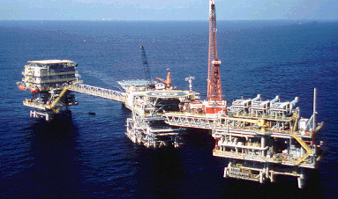
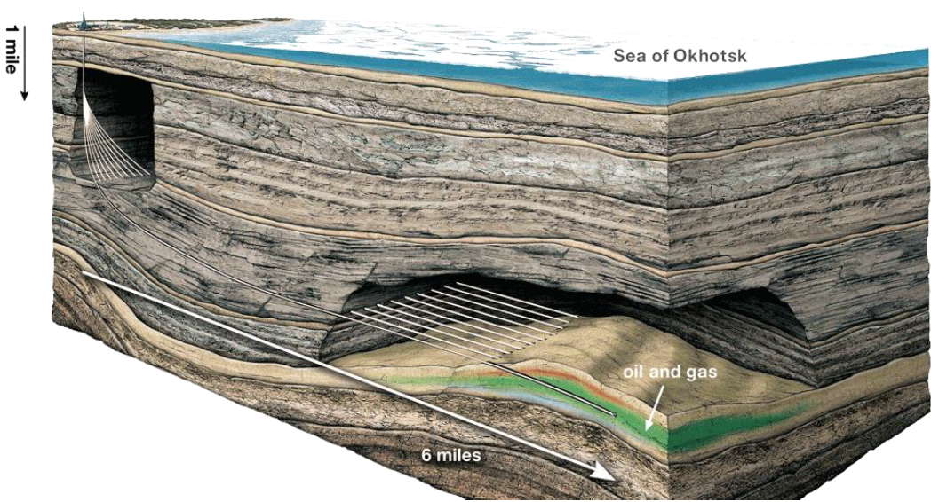

The Upstream – Decision Under Uncertainty
Reservoir Management
Development Planning & Execution
Top Side Facilities
Drilling &
Subsurface

Slide 3
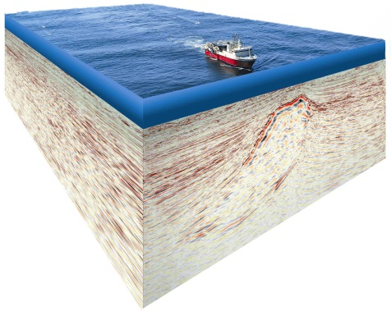
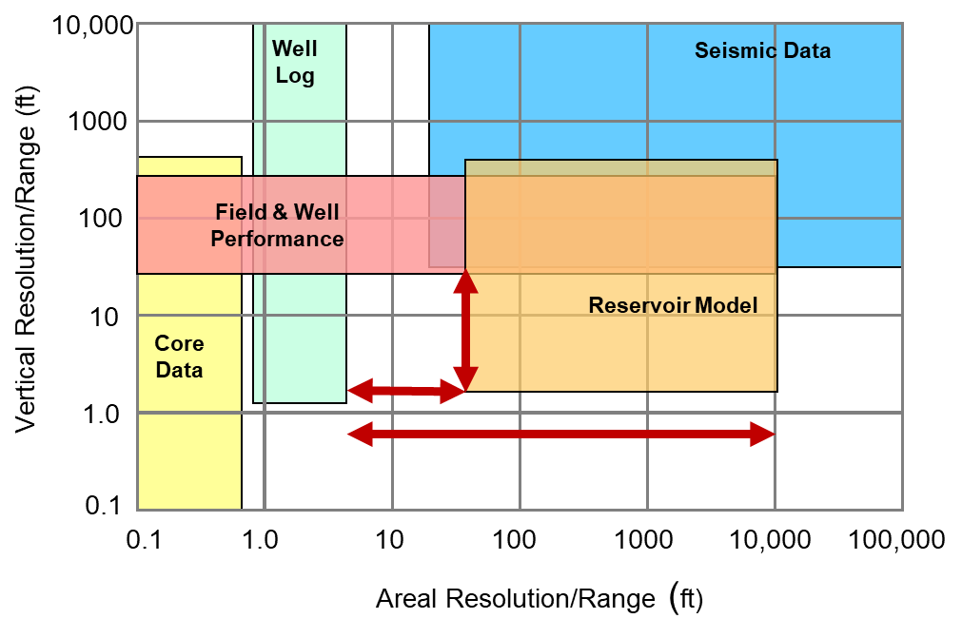
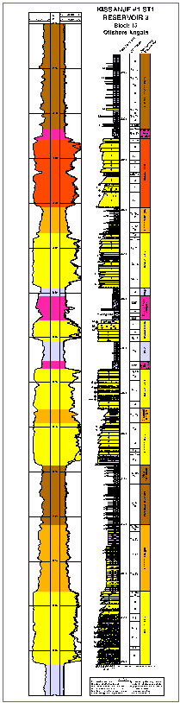
The Upstream – Subsurface Decision Support
Well Test
Reservoir Characterization
Subsurface Imaging
Reservoir Modeling & Simulation
Appraisal
logging & coring

Slide 4
Multiphase Flow in the Upstream
Flow in porous media (typical three phase, black-oil or compositional)
  May be coupled with geo-mechanics, thermal process
  Reservoir performance prediction to support field development and production operations
  Darcy flow at field scale, can be non-Darcy near wells; Stokes flow in pore space; turbulent flow in well bores and some carbonate formations
Particulate flows
  Drilling and completion (cutting removal, sand control) and flow assurance in facility and pipelines
  Hydraulic fracturing: proppant transport in fracturing fluid, coupled with fracture/geo-mechanics
Sediment gravity flows (typically not considered multiphase)
  Sedimentary processes controlling siliciclastic reservoir formations: turbidity current, debris and mud flows
  Used to understand geologic formations and predict reservoir rock property distributions
Common challenges: multi-scale (space & time), multi-physics, uncertainty, inference & inversion

